Slide 1

Guatemala SQL Server group
September 2018

Slide 2
Board Members
Christian Araujo - @charaujo
Carlos Lopez - @CarlosLopezSQL
Eduardo Pivaral - @EduardoDBA
Carlos Robles - @dbamastery
gtssug.pass.org
github.com/GTSSUG *New

Slide 3

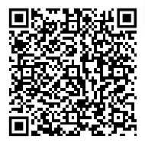
LSDISM0UC
PASS Summit 2018 Registration Offer
Save $150 USD
Register for PASS Summit and as a member of SQL Server local user group Guatemala you can save $150 USD off your conference registration price.
To access your exclusive discount, use code LSDISM0UC when you register and your savings will calculate at time of registration. Register between September 17 – 22, 2018 and be entered into a daily prize draw, and grand prize draw for a COMP to PASS Summit 2019**!
*Unique discount code cannot be applied retroactively and cannot be combined with any other offers.
** Terms and Conditions apply – scan QR code to view.
GROUP REFERRAL DISCOUNT CODE
PASS Summit is the largest conference for technical professionals who leverage the Microsoft Data Platform.
Get the skills and community connections you need to advance your company and career.

Slide 4

Attending PASS Summit? Then you’ve been granted EXCLUSIVE access to buy PASS gear on the PASS Stuff online store!
Pre-Order for pickup onsite at PASS Summit only. All orders must be placed by the attendee picking up the item at PASS Summit.
Visit PASSstuff.com for more!

Slide 5
Upcoming Virtual Group Webinars
VIRTUAL GROUP | MEETING DATE | TOPIC
Powershell | September 26, 2018 18:00 - 19:00 UTC | Power your Raspberry Shell on it's Core. Raspberry Pi + PowerShell Core - Daniel Silva
Cloud | September 27, 2018 18:00 - 19:00 UTC | The Evolution of SQL as a Service - Azure SQL Database Managed Instance - Javier Villegas
DBA Fundamentals | October 2, 2018 11:00 - 12:00 UTC | Administering Beyond the Speed of Light : Managing SQL Server with Ansible - Brian Carrig
DBA Fundamentals | October 9, 2018 02:30 - 01:30 UTC | Let’s talk about Big Data using SQL Datawarehouse - Victor Fava
High Availability & Disaster Recover | October 9, 2018 18:00 - 19:00 UTC | SQL Server 2017 – Always on Availability Groups - Windows and Linux Deployments - David Pless

Slide 6
Upcoming Virtual Group Webinars
VIRTUAL GROUP | MEETING DATE | TOPIC
Women in Technology | October 10, 2018 17:00 - 18:00 UTC | SQL Server with Docker Containers - Marsha Pierce
Global Italian | October 10, 2018 17:00 - 18:00 UTC | Custom Mobile Reports in Reporting Services - Andrea Martorana Tusa
Data Architecture | October 10, 2018 18:00 - 19:00 UTC | Pester the Tester: PowerShell Bugs Beware! - Robert Cain
Cloud | October 11, 2018 18:00 - 19:00 UTC | Insights with Massive Data Ingestion and Power BI - Armando Lacerda
Professional Development | October 12, 2018 16:00 - 17:00 UTC | Project Management: A substitute or a supplement to your career? - Raj Heda

Slide 7
Upcoming Virtual Group Webinars
VIRTUAL GROUP | MEETING DATE | TOPIC
Saturday Night SQL | October 14, 2018 02:00 - 03:30 UTC | Blocking and Deadlocks Troubleshooting in SQL Server - Dmitri Korotkevitch
DBA Fundamentals | October 16, 2018 17:00 - 18:00 UTC | 5 Shifts to Becoming a Rockstar Data Professional (Without the Stress and Burnout Caused by Being in IT) - Edwin Sarmiento
Cloud | October 25, 2018 18:00 - 19:00 UTC | Agile Data Warehousing in the Cloud - Michael Tantrum

Slide 8

Upcoming SQLSaturdays
US/Canada
EMEA
Sep 22 San Diego
Sep 22 Atlanta – BI Edition
Sep 22 Boston
Sep 29 Pittsburgh
Oct 06 Orlando
Oct 06 Minnesota
Oct 06 Memphis
Oct 13 Columbus, GA
Oct 20 Charlotte
Oct 27 Lincoln
Sep 22 Kharkiv
Sep 22 Lisbon
Sep 29 Porto, Portugal
Sep 29 Lviv
Oct 06 Bucuresti
Oct 06 Denmark
Oct 13 Holland
Oct 13 Sofia
Oct 20 Madrid
Oct 27 Munich
LATAM
Sep 29 São Paulo
Oct 06 Puerto Rico
Oct 13 El Salvador
Oct 20 Salvador
Visit sqlsaturday.com to register for an event near you!

Slide 9

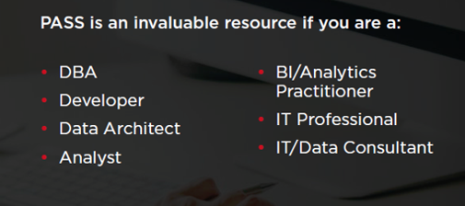
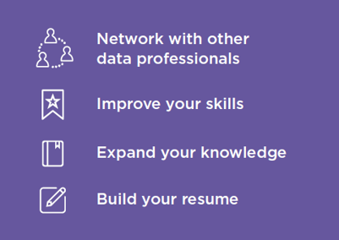

Join PASS to Grow Your Career
Connect with a global network of 250,000+ data professionals
Become a member and gain free access to:
Online educational content
Live webinars
In-person meetups, events, and conferences
Networking, volunteering, and speaking opportunities
The Community
The Benefits
… Join Today!
Notes:
PASS is a global, not-for-profit association where data professionals Connect, Share and Learn.
Joining PASS is free, and gives you access to hundreds of hours of free online content, live virtual and in-person events, the ability to join Local Groups in your area, and an annual conference, PASS Summit.
PASS is a great way to connect with like-minded professionals, increase your technical expertise, and grow your career.

Slide 10

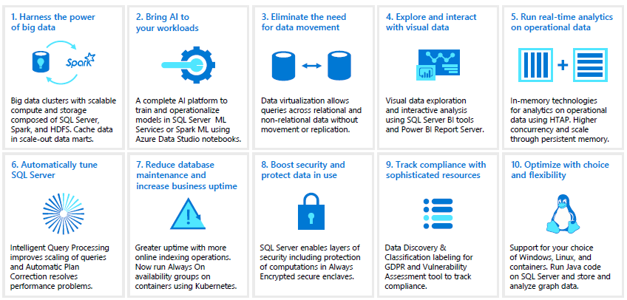
Newsletter
SQL Server 2019 CTP: it is live! you can learn more about the new features and give it a try:
https://www.microsoft.com/en-us/sql-server/sql-server-2019

Slide 11
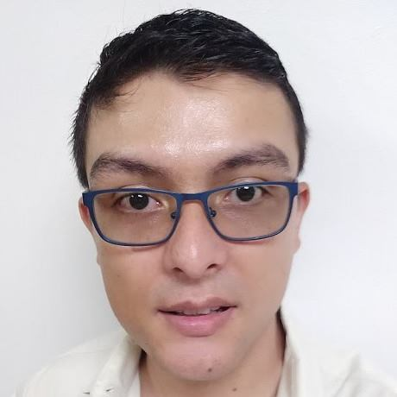
Congratulations to Allan Fong for his new job!!!

Slide 12


Eduardo Pivaral (@EduardoDBA) blog posts were featured in September 15th SQL Server Central newsletter
http://www.sqlservercentral.com/NewsletterArchive/2018/09/15/17531178

Slide 13
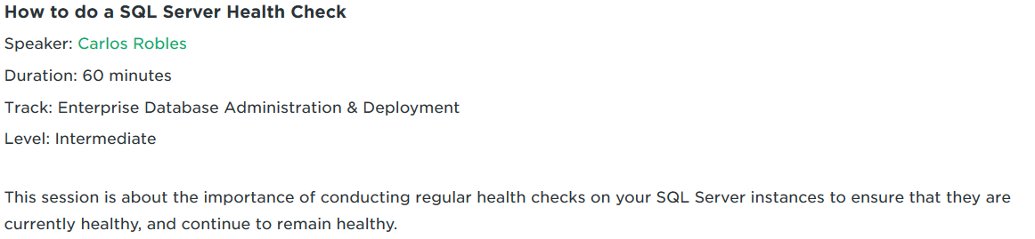
Carlos Robles (@dbamastery) Participated as speaker in SQL Saturday #774 in Denver, with the topic:
How to do a SQL Server Health Check
https://www.sqlsaturday.com/774/Sessions/Details.aspx?sid=77464

Slide 14

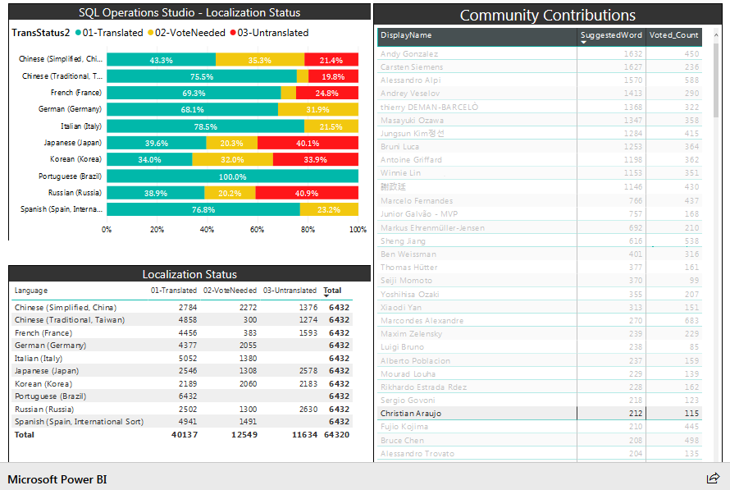
Christian Araujo (@charaujo) Participated as translator for the Azure Data Studio tool (formerly known as SQL Server Operations Studio) and up to date 115 of 212 contributions were approved.
you can help him by voting/reviewing his translations at:
https://envelope-community.azurewebsites.net/translation/index?pid=3310a3ac-505e-41e1-9c4d-1074749d987b

Slide 15
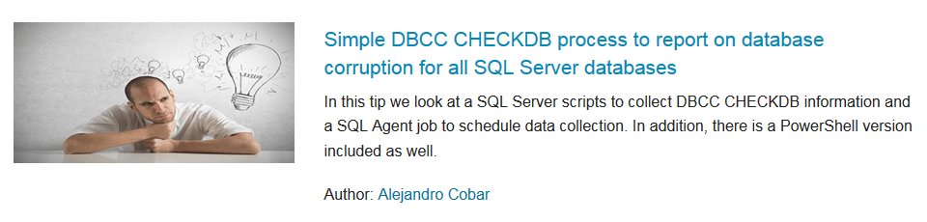
Alejandro Cobar latest tip was featured in September 25th MSSQL Tips homepage and newsletter
https://www.mssqltips.com/sqlserverauthor/321/alejandro-cobar/

Slide 16
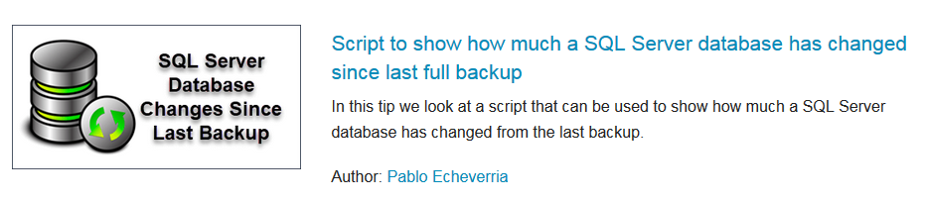
Pablo Echeveria (@pabechevb) latest tip was featured in September 14th MSSQL Tips homepage and newsletter
https://www.mssqltips.com/sqlserverauthor/267/pablo-echeverria

Slide 17
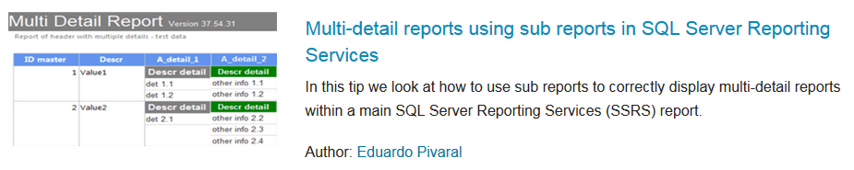
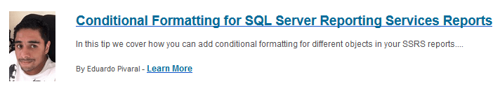
Eduardo Pivaral (@EduardoDBA) latest tips were featured in September 4th and 19th MSSQL Tips homepage and newsletter
https://www.mssqltips.com/sqlserverauthor/315/eduardo-pivaral/

Slide 18

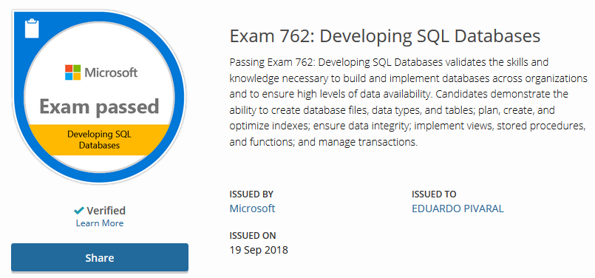
Eduardo Pivaral (@EduardoDBA) Obtained a certification on September 19th
Microsoft Certified Solutions Expert: Data Management and Analytics
https://www.youracclaim.com/users/eduardo-pivaral

Slide 19
Main Presentation
Introduction to Query Store
Carlos Robles, Principal Consultant DBA Mastery
Fixing SQL Server performance problems and detecting query regressions has been always challenging for DBAs, we have to deal with the fact that SQL Server does not capture query performance stats permanently on disk.
Query Store is a new feature introduced in SQL Server 2016, which automatically captures a history of queries, plans, and runtime statistics, and retains these for later review.
About Carlos:
He is a very experienced multi platform DBA (MySQL, Oracle, SQL Server, SQL Azure) with over 10 years of experience in the field. He has worked in database support as primary consultant and DBA manager for larger US based clients and around the work in the healthcare, insurance, retail, food and energy industries. He has a few certifications under his belt MCP, MCTS, MCSA & MCSE and ITIL v3. International speaker, Guatemala group leader who enjoys to like people using the #SQLHelp hashtag in Twitter during this spare time. Love everything related to technology, sci-fi and video games!

Slide 20

Sponsors
Want to become a sponsor? Send an email to: gtssug@gmail.com

Slide 21
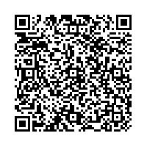
Resources
For all the links just scan the following QR code:

Slide 22


Follow us
Sign up for a free membership today at:
GTSSUG.PASS.org
#SQLPassGT @gtssug

Slide 23


Connect with PASS
Sign up for a free membership today at:
PASS.org
#sqlpass @sqlpass
@passcommunity

